Slide 1

Azure Pipelines
Prasoon Gumasta
➔
https://dev.azure.com/

Slide 2
What is DevOps? Why we need it? How we can achieve it?
➔
https://dev.azure.com/

Slide 3





Azure DevOps
Better together
Azure Boards
Azure Repos
Azure Pipelines
Azure Test Plans
Azure Artifacts
An end-to-end solution for organizations looking for an enterprise-grade toolchain
Fully Integrated with end to end traceability
Scalable to any team and project size
Highly available, multi region, hybrid cloud & on-prem
Customer Support
Consistent admin and access control
➔
https://dev.azure.com/

Slide 4
Introducing Azure DevOps
Azure Boards
Azure Pipelines
Azure Repos
Deliver value to your users faster using proven agile tools to plan, track, and discuss work across your teams.
Build, test, and deploy with CI/CD that works with any language, platform, and cloud. Connect to GitHub or any other Git provider and deploy continuously.
Get unlimited, cloud-hosted private Git repos and collaborate to build better code with pull requests and advanced file management.
Azure Test Plans
Azure Artifacts
➔
Test and ship with confidence using manual and exploratory testing tools.
Create, host, and share packages with your team, and add artifacts to your CI/CD pipelines with a single click.
https://dev.azure.com/

Slide 5



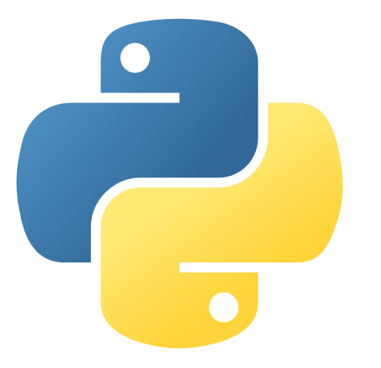








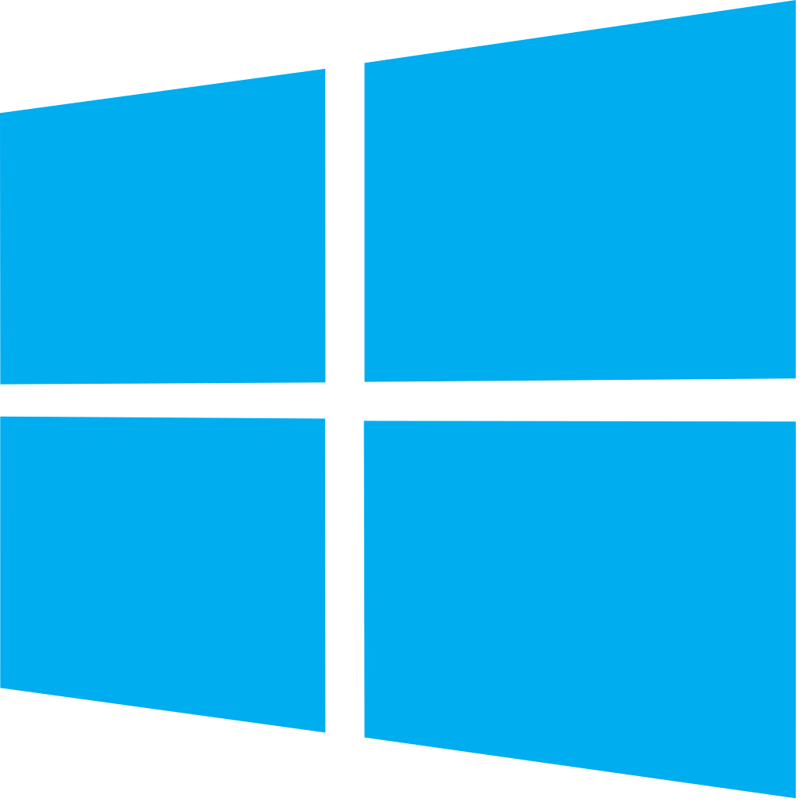


Azure DevOps: Choose what you love
Your tools, languages, and clouds
Azure DevOps lets developers choose the tools and languages that are right for them
Mix and match to create workflows with tools from Microsoft, open source or your favorite 3rd party tools
Target any cloud, on-prem or both and deploy to the servers you need

Slide 6

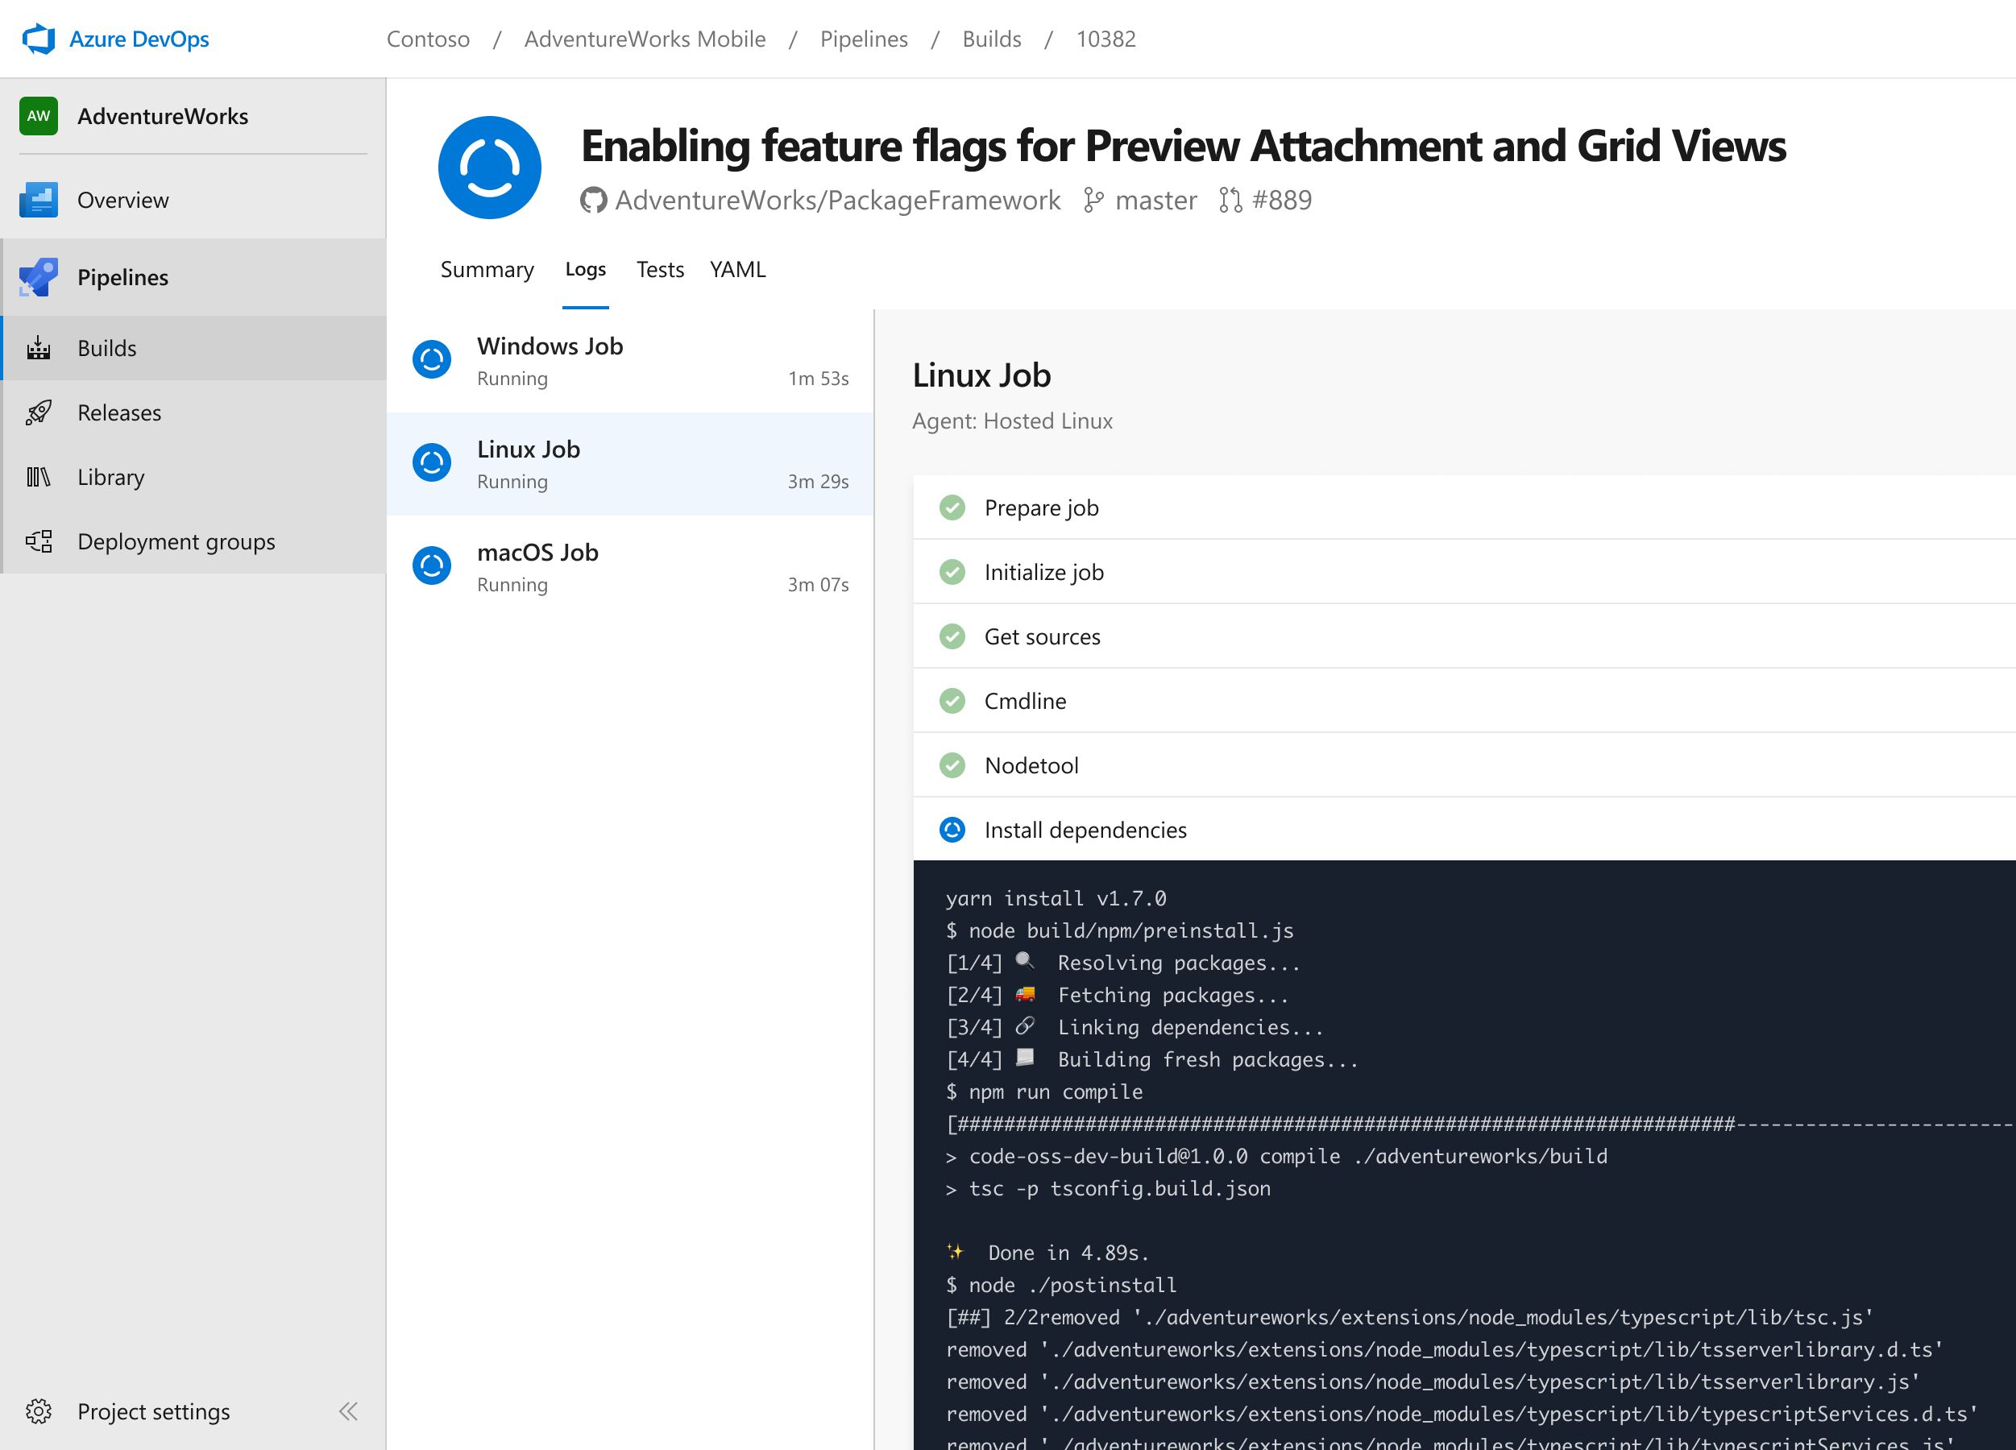


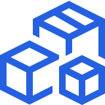

Azure Pipelines
Cloud-hosted pipelines for Linux, Windows and macOS, with unlimited minutes for open source
Any language, any platform, any cloud
Build, test, and deploy Node.js, Python, Java, PHP, Ruby, C/C++, .NET, Android, and iOS apps. Run in parallel on Linux, macOS, and Windows. Deploy to Azure, AWS, GCP or on-premises
Extensible
Explore and implement a wide range of community-built build, test, and deployment tasks, along with hundreds of extensions from Slack to Sonar Cloud. Support for YAML, reporting and more
Flexible deployments:
EasilyDeploy to Kubernetes, VMs, Azure Functions, Azure Web Apps, or any cloud. Use stages, gates, and approvals to create a deployment strategy that’s right for you and ensures quality at every step. Even deploy
Easily integrate with third part tools. Like Jenkins, GitHub
➔
https://dev.azure.com/

Slide 7

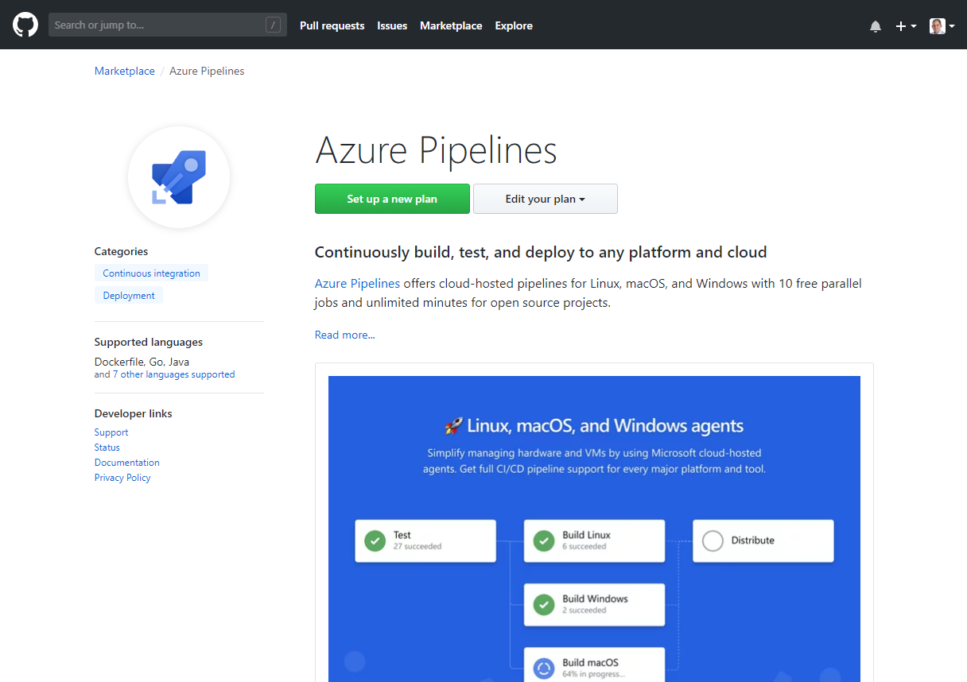
Integrated with GitHub
Azure Pipelines available now to any developer from the GitHub Marketplace

Slide 8

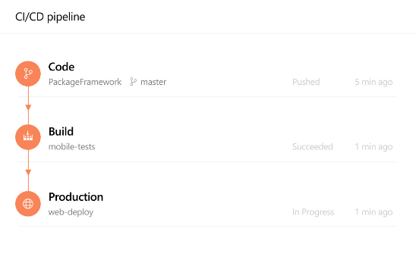
Azure Pipelines
Builds
Releases

Slide 9
Building & Deploying Azure pipeline with Azure DevOps
Demo

Slide 10
Thank you!
Prasoon Gumasta
prasoon.Gumasta@itcinfotech.com

Slide 11

Azure Pipelines
Microsoft Open Source
Free unlimited build minutes for public projects
Up to 10 free parallel jobs across Windows, Linux and macOS

